Slide 1
Water purification
Anna Kroczková, Dorota Baszczynská, Magdalena Fajkus

Slide 2
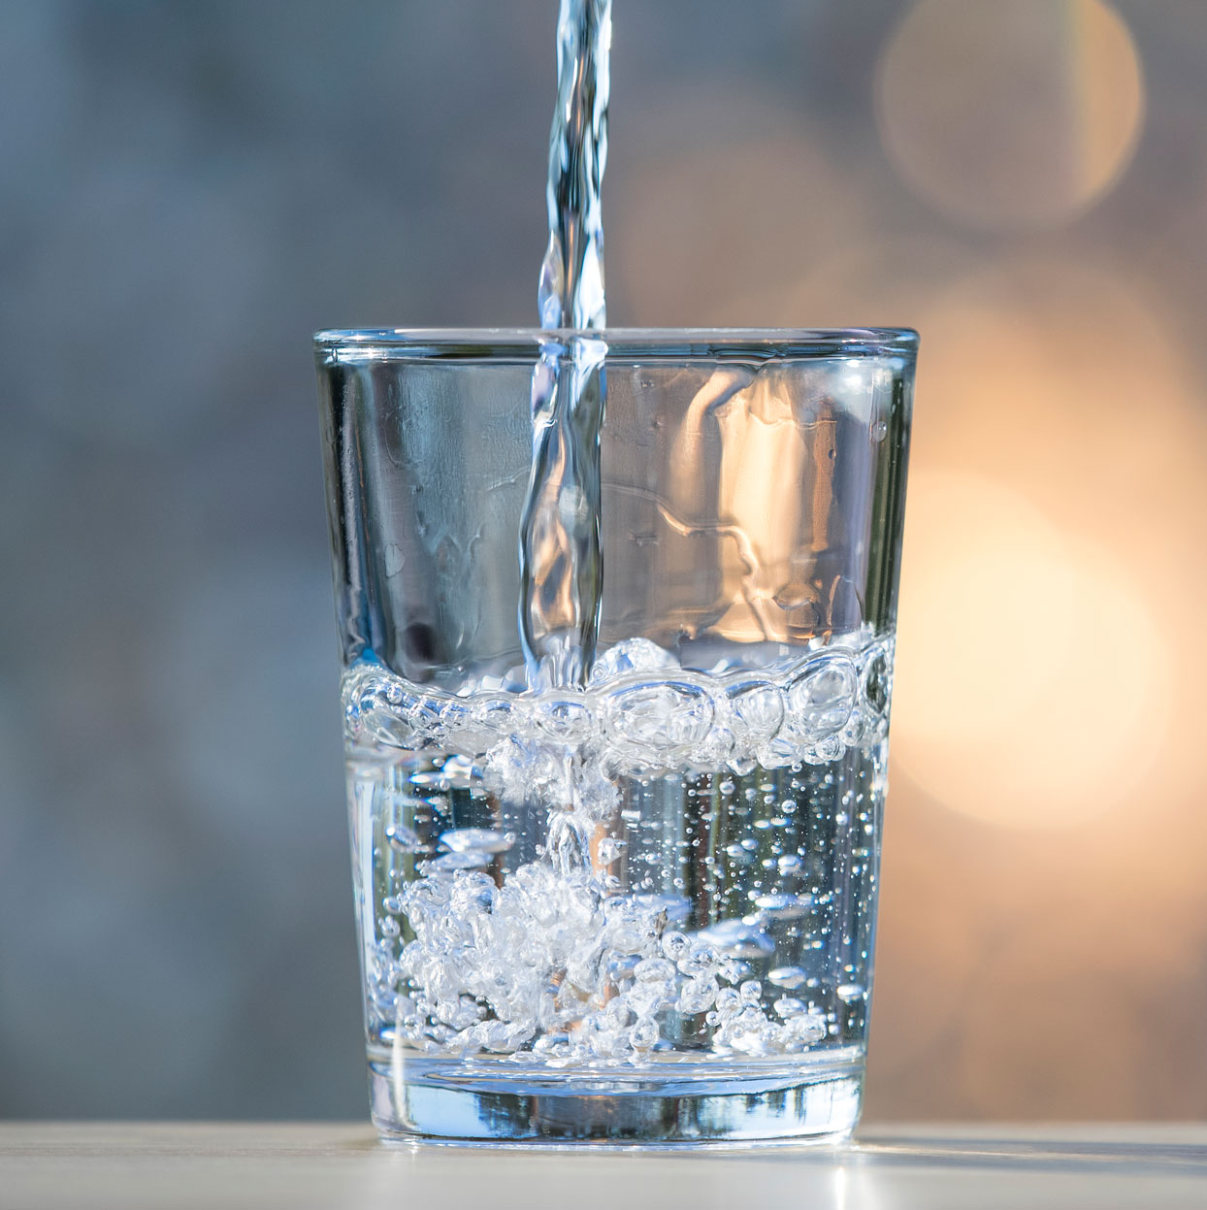
Water purification - what is it about?
Water purification is a process of eliminating all undesirable elements in the water.
The goal of this technique is to make the water suitable for its intended purpose.
Water purification = transformation of wastewater into service water.

Slide 3
Undesirable elements in water
01
Suspended solids
02
Gases
03
Biological contaminants
04
Chemicals
sand, sediment, and plankton
carbon dioxide, hydrogen sulfide, methane, and radon
nitrogen, bleach, salts, pesticides, metals, toxins produced by bacteria, and human or animal drugs.
include bacteria, molds, mildew, viruses, house dust, mites, and pollen

Slide 4
01
Wastewater treatment process

Slide 5
Cleaning methods
Sedimentation
Membrane separation processes
Filtration.
Magnetic separation.
Ion exchange.
Coagulation.

Slide 6
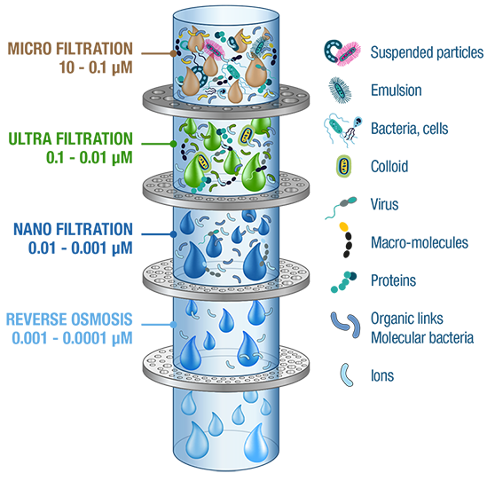
The main process - explained step by step

Slide 7
—Finally a video! :)
https://www.youtube.com/watch?v=-yIsedPYzZ8

Slide 8
Thank you
for your attention

